Slide 1
DEV CONTAINERS
From DEVELOPMENT TO DEPLOYMENT
Venkatt Guhesan
Dec. 2022

Slide 2
Our journey so far
Two Variants of Dev Containers and Code/Install Isolation
Using the Dev Container extension, we looked at samples to auto-generate “docker-compose.yaml” as part of the workspace.
Looked into converting a “docker-compose.yaml” file to a collection of Kubernetes configuration files using Kompose.
We then took the collection of Kubernetes configuration files to assemble them into a config document to generate a single Kubernetes manifest file using Kustomize.
NixOS.org
Dev Containers and using VSC Templates and “Dev Container” extension as a starting point for our Dev Containers

Slide 3
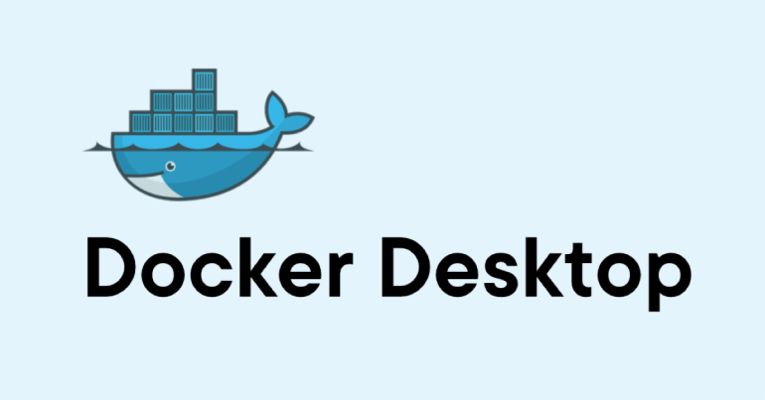
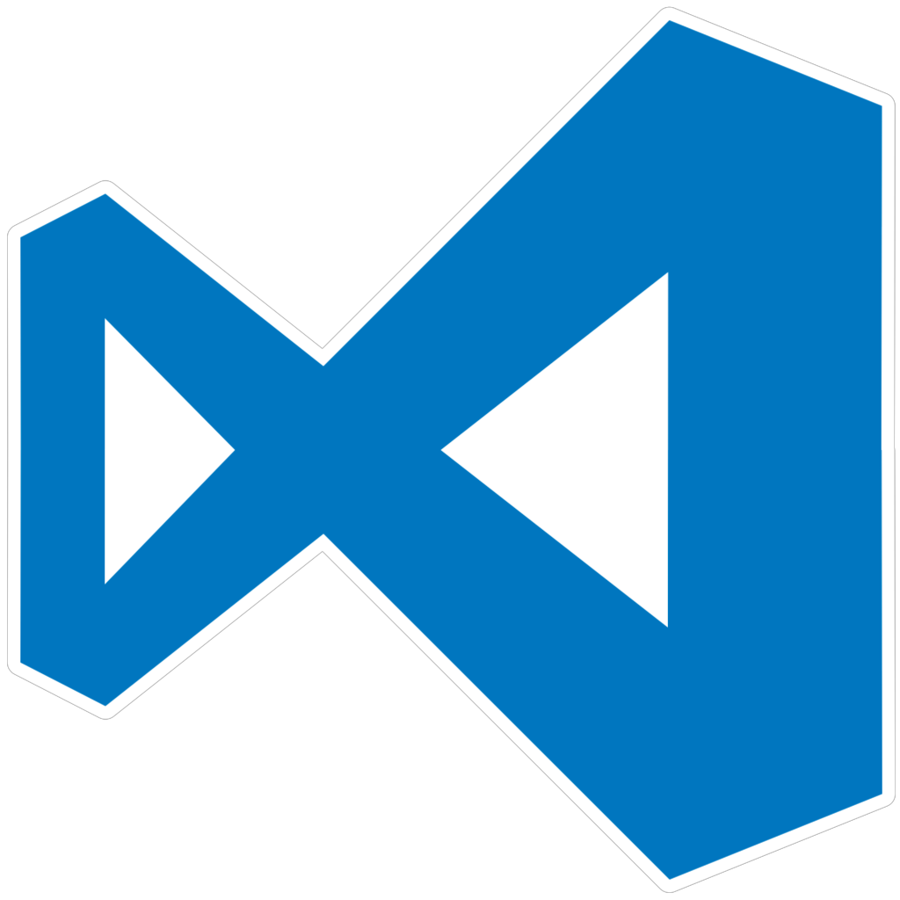
Our Development Environment
+
+
Dev Containers
With Kubernetes enabled
Visual Studio Code
Cross-Platform Solution
Works the same in Windows, Mac and Linux

Slide 4
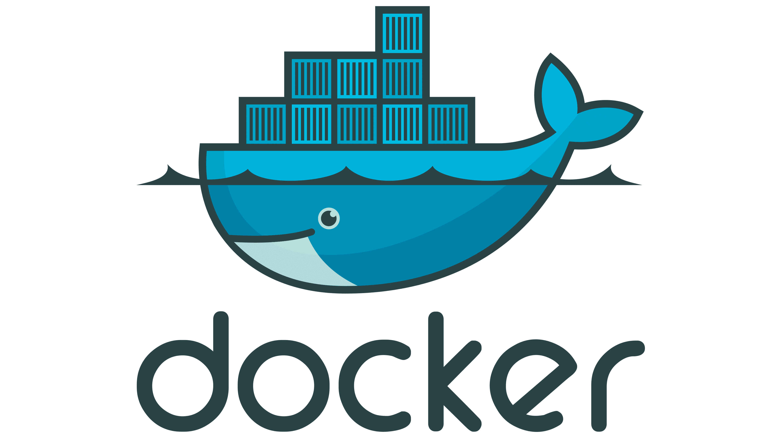
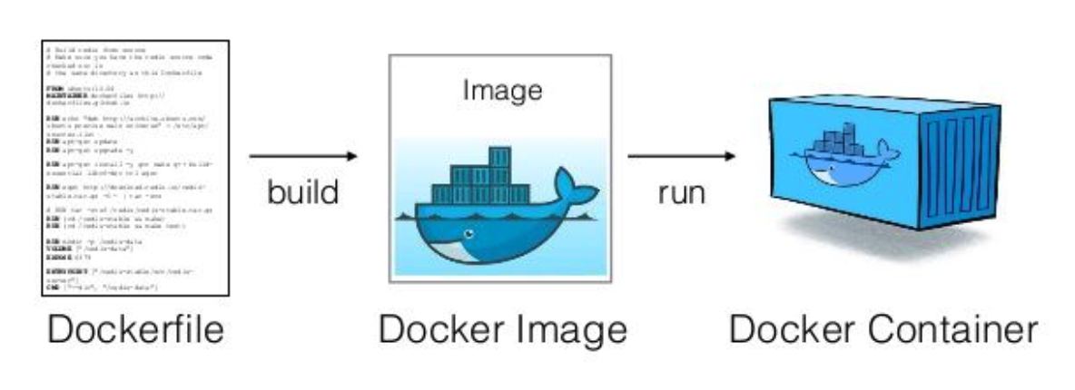
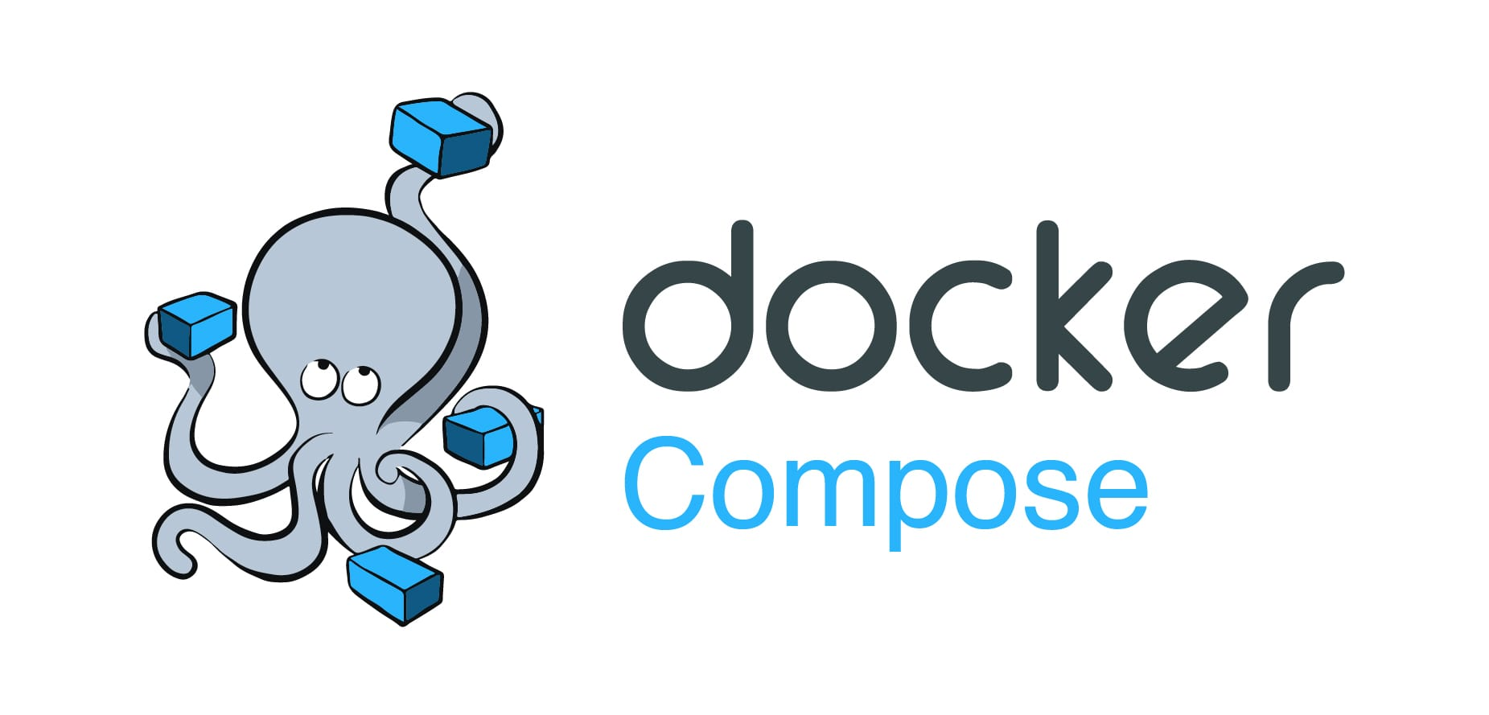
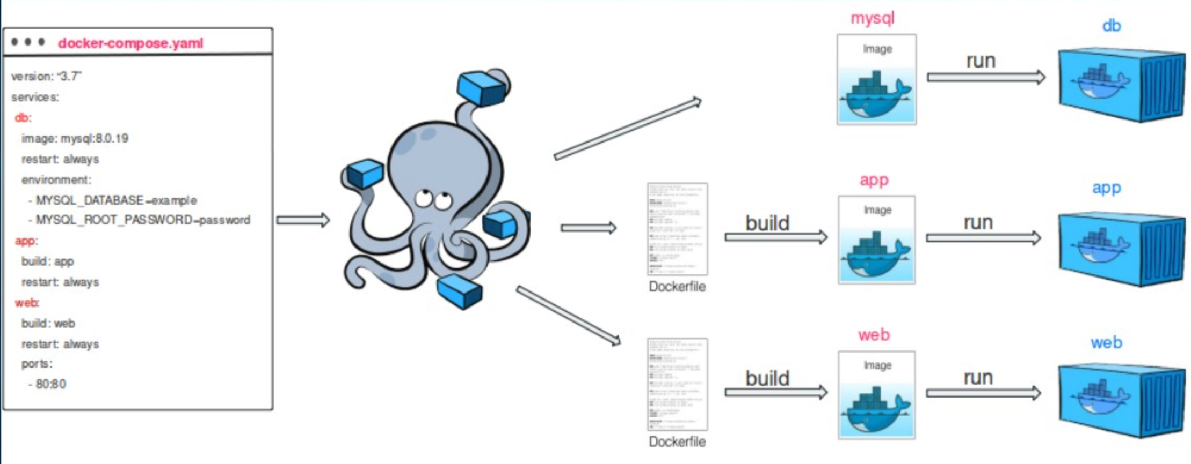
Docker vs. Docker Compose
Quick Links
Docker vs Docker Compose

Slide 5
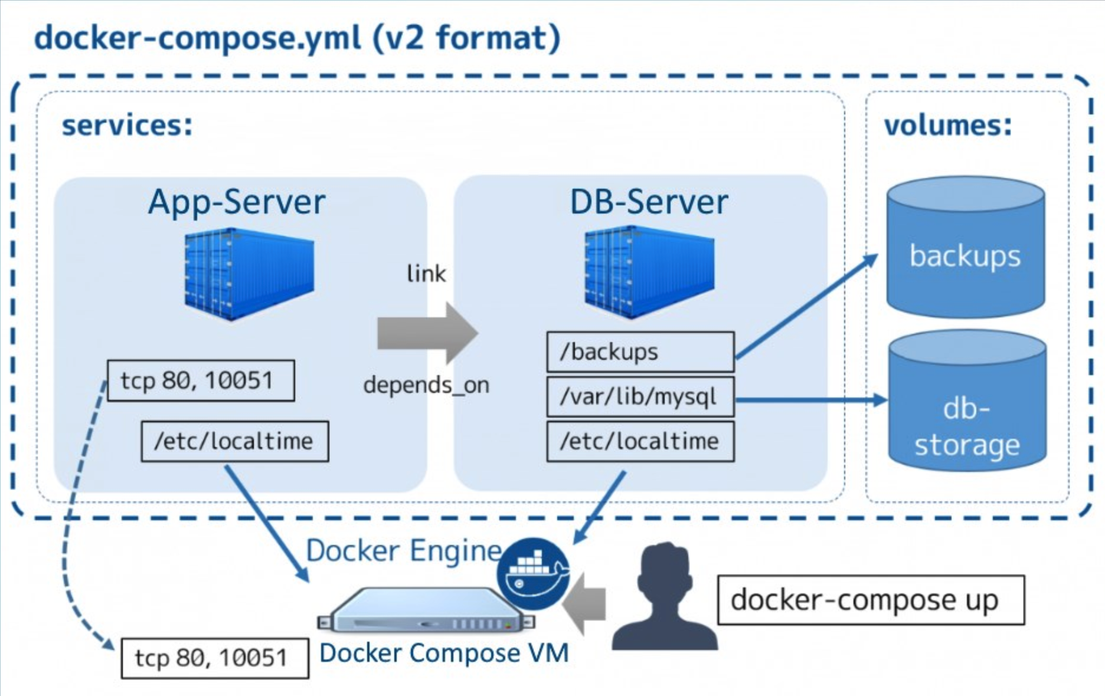
Docker Compose v2 Format
Docker Compose is a private-label of Fig by Orchard Up
Compose File:
compose.yaml
compose.yml
docker-compose.yaml
docker-compose.yml
Learn more…
Docker-Compose is Docker’s flavor of Kubernetes Orchestration

Slide 6

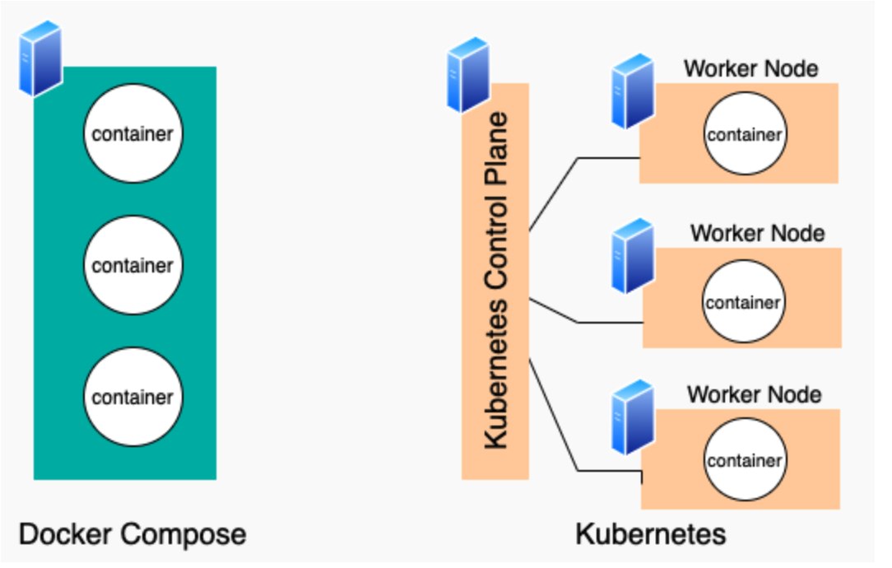


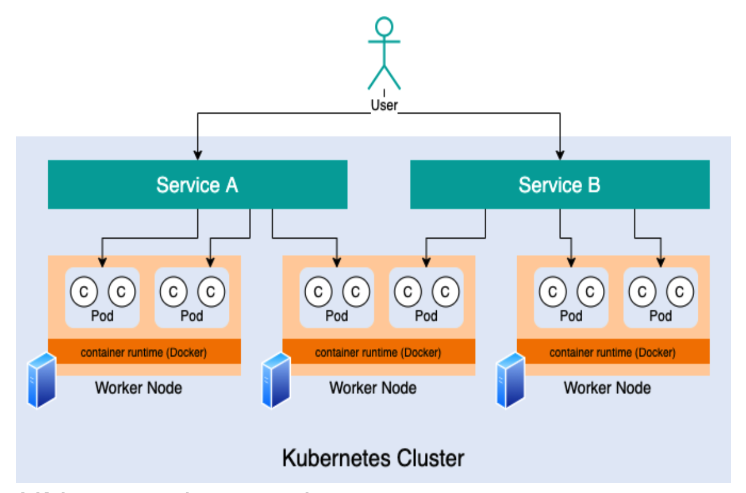

Docker Compose vs Kubernetes
The main difference is that Kubernetes runs containers across multiple computers, whether virtual or physical, whereas Docker Compose runs containers on a single host machine (for our development needs).

Slide 7
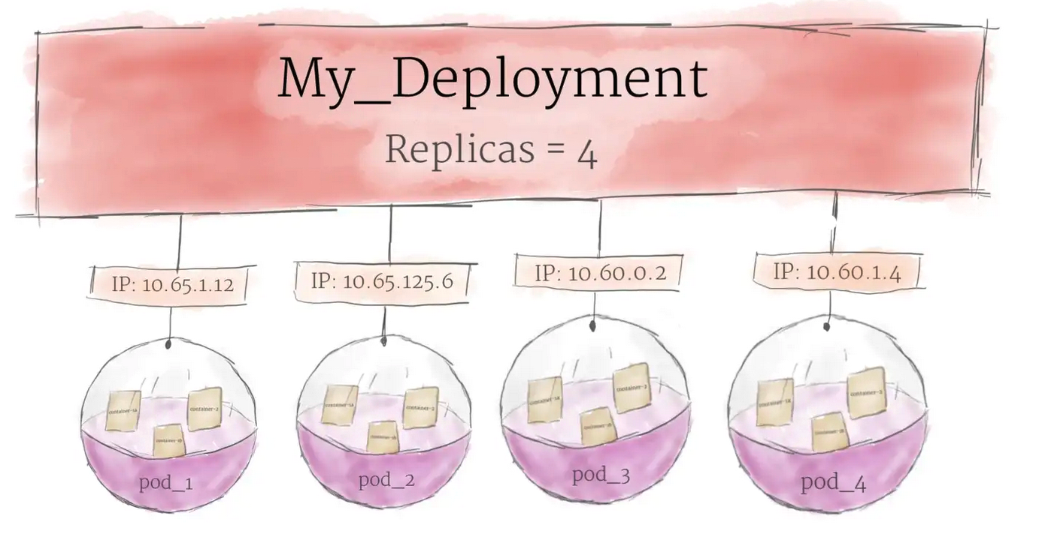
Pod in detail
credit

Slide 8
K8s cont.
Pod
Pod is the basic unit of work and the smallest deployable unit of computing that you can create and manage in Kubernetes.
Pod is a group of one or more containers, with shared storage and network resources, and a specification for how to run the containers.
Pod is a thin wrapper around one or more containers.
Namespace
Namespaces provides a mechanism for isolating groups of resources within a single cluster.
Names of resources need to be unique within a namespace, but not across namespaces.
Namespace-based scoping is applicable only for namespaced objects (e.g. Deployments, Services, etc) and not for cluster-wide objects (e.g. StorageClass, Nodes, PersistentVolumes, etc).
Namespaces enable organizing resources into non-overlapping groups (for example, per tenant, per environment, per project, per team)
Learn more . . .

Slide 9
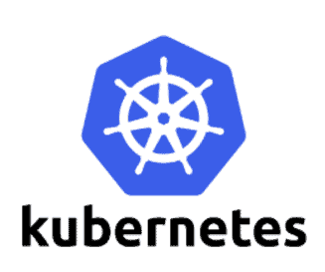
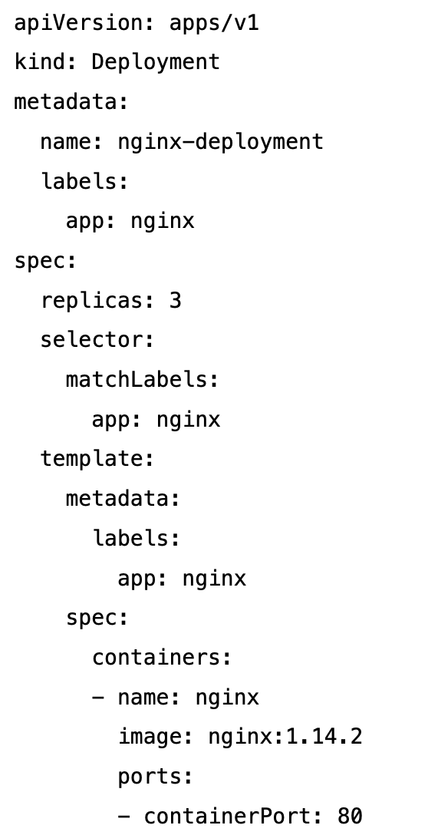
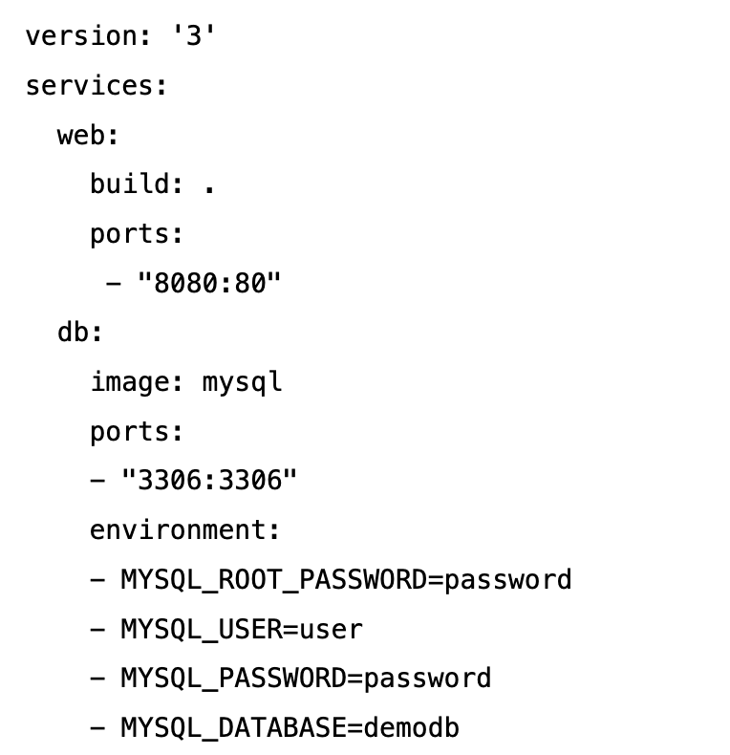
Docker & Kubernetes Key Differences
Kubernetes Deployment Template
docker-compose.yaml

Slide 10
Docker & Kubernetes Key Differences
Kubernetes Objects/Resources/Kinds
$ kubectl api-resources
Docker Compose
Application Model
NAME SHORTNAMES KIND
bindings Binding
componentstatuses cs ComponentStatus
configmaps cm ConfigMap
endpoints ep Endpoints
events ev Event
limitranges limits LimitRange
namespaces ns Namespace
nodes no Node
persistentvolumeclaims pvc PersistentVolumeClaim
persistentvolumes pv PersistentVolume
pods po Pod
podtemplates PodTemplate
replicationcontrollers rc ReplicationController
resourcequotas quota ResourceQuota
secrets Secret
serviceaccounts sa ServiceAccount
services svc Service
initializerconfigurations InitializerConfiguration
mutatingwebhookconfigurations MutatingWebhookConfiguration
validatingwebhookconfigurations ValidatingWebhookConfiguration
customresourcedefinitions crd,crds CustomResourceDefinition
apiservices APIService
controllerrevisions ControllerRevision
daemonsets ds DaemonSet
deployments deploy Deployment
replicasets rs ReplicaSet
statefulsets sts StatefulSet
tokenreviews TokenReview
localsubjectaccessreviews LocalSubjectAccessReview
selfsubjectaccessreviews SelfSubjectAccessReview
selfsubjectrulesreviews SelfSubjectRulesReview
subjectaccessreviews SubjectAccessReview
horizontalpodautoscalers hpa HorizontalPodAutoscaler
cronjobs cj CronJob
jobs Job
brpolices br,bp BrPolicy
clusters rcc Cluster
NAME SHORTNAMES KIND
filesystems rcfs Filesystem
objectstores rco ObjectStore
pools rcp Pool
certificatesigningrequests csr CertificateSigningRequest
leases Lease
events ev Event
daemonsets ds DaemonSet
deployments deploy Deployment
ingresses ing Ingress
networkpolicies netpol NetworkPolicy
podsecuritypolicies psp PodSecurityPolicy
replicasets rs ReplicaSet
nodes NodeMetrics
pods PodMetrics
networkpolicies netpol NetworkPolicy
poddisruptionbudgets pdb PodDisruptionBudget
podsecuritypolicies psp PodSecurityPolicy
clusterrolebindings ClusterRoleBinding
clusterroles ClusterRole
rolebindings RoleBinding
roles Role
volumes rv Volume
priorityclasses pc PriorityClass
storageclasses sc StorageClass
volumeattachments VolumeAttachment
Services
Networks
Volumes
Configs
Secret

Slide 11

Our Next Objective
Learn to develop a three-tiered application using Dev Containers

Slide 12


System View
8080
8081
User loads a web site driven by Flask Web (on port: 8080) and then invokes API calls to a FastAPI REST middleware (on port: 8081). API calls are backed by a PostgreSQL DB that stores the needed data.
Flask Web
FastAPI REST
5432
PostgreSQL
DB

Slide 13
Component View
8080
8081
External
Internal
8080
8081
Flask Web delivers the front-end
FastAPI REST delivers the API Tier
PostgreSQL delivers the storage tier
Flask Web
FastAPI REST
PostgreSQL
DB
5432

Slide 14
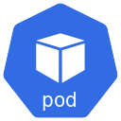

One Possible Systems Architecture
8080
8081
Namespace: dev
8080
8081
5432
Docker-Images:
frontend
middleware
Postgresql (backed by a storage volume)
Image: frontend
Image:
middleware
Image:
db
secrets
Postgres-User-ID
Postgres-Password
Storage
Volume
Although we can create further network isolation between (middleware + db) from frontend to avoid any possibility of connecting to the db tier from frontend, for our use-case this is adequate.

Slide 15
Alternate Systems Architecture
Namespace: dev
Network Isolation
8080
8081
Network Isolation
8080
8081
5432
Docker-Images:
frontend
middleware
Postgresql (backed by a storage volume)
Image #1 frontend
Image #2
middleware
Image #3
db
secrets
Postgres-User-ID
Postgres-Password
Storage
Volume
Internally they can all talk to each other container instances within a pod
Although we can create further network isolation between (middleware + db) from frontend to avoid any possibility of connecting to the db tier from frontend, for our use-case this is adequate.
Best Practices

Slide 16
Alternate Systems Architecture
8080
8081
8080
8081
5432
Docker-Images:
frontend
middleware
Postgresql (backed by a storage volume)
Image #1 frontend
Image #2
middleware
Image #3
db
secrets
Postgres-User-ID
Postgres-Password
Storage
Volume
Internally they can all talk to each other container instances within a pod
Although we can create further network isolation between (middleware + db) from frontend to avoid any possibility of connecting to the db tier from frontend, for our use-case this is adequate.
Best Practices

Slide 17
Yet Another Alternate View
From a Microservices point-of-view
8081
or
Kube-Proxy Ingress Controllers
8081
Image:
API Gateway Service
Quick Links
Kubernetes Ingress
Ingress Controllers
Image:
Middleware Auth
Image:
Middleware Products
Image:
Middleware Shopping Cart
Image:
Middleware Card Services
Image:
Middleware Shipping
You want to design a pod depending on how you want to scale. You scale at a pod level.
If your desire is to scale the “Auth” container independently with more replicas, then a pod with just that “Auth” container becomes your unit (pod) Whereas, if your objective is to scale all parts (all containers – Auth, Products, Shopping Cart, Card Services, Shipping ) uniformly then what you see in the diagram to the left becomes the pod.
NOTE: Any containers in the same pod will share the same resources and local network.
Image:
db
Storage
Volume

Slide 18


GIT View
projdevcontainers
root-project
GIT
kubernetes
.devcontainer
devcontainer.json
docker-compose.json
frontend
sub-project: frontend
GIT
dockerfile
…
GIT
middleware
sub-project: middleware
dockerfile
…
db
sub-project: db
GIT
dockerfile
database-primer.sql

Slide 19
Container Image Env Diffs
✼ DEVELOPMENT ✼
Python Flask Container Image
Python FastAPI Container Image
Golang Container Image
Java Container Image
Python
Pip
Flask
Jinja
Werkzeug
Etc.
Python
Pip
FastAPI
Etc.
Go
go-releaser
makefile
make
JDK
Spring Framework
maven
Other Dependency JARs
dockerfile
dockerfile
dockerfile for DEV
dockerfile for DEV
<- -Interpreted Languages
Compiled Languages - - >
dockerfile for non-DEV
dockerfile for non-DEV
✼ PRODUCTION ✼
Python Flask Container Image
Python FastAPI Container Image
Golang Container Image
Java Container Image
Python
Pip
Flask
Jinja
Werkzeug
Etc.
Python
Pip
FastAPI
Etc.
Just the binary with a RUN
App-JAR or WAR
JRE

Slide 20
Our Goal
Create dockerfile for PostgreSQL database
Create middleware (FastAPI REST) Python code
Create dockerfile for containerizing middleware
Create frontend (Flask) Python code
Create dockerfile for containerizing frontend
Create a “compose.yaml” (previously docker-compose.yaml) to tie up all the parts into one cluster.
Use kompose to convert compose.yaml into Kubernetes manifest files.
Use kubectl (kind: Kustomization) to kustomize (combine) into one merged manifest file.
Use the single manifest file to deploy local K8s cluster.
Test application
Where does “.devcontainer” fit in?

